Slide 1
TM354 Block 3 From architecture to product
Chris Thomson c.d.thomson@open.ac.uk

Slide 2
Plan
Review OCL
Review unit 9
Get an overview of the topics covered in units 10 and 11
Make sure you get the primers from the tutor group forum, and annotate them as we go along!

Slide 3
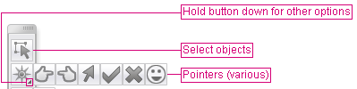
Tell me how you are feeling
Use your pointer to help me know when to move on with a topic
Far left means I understand this move on
Middle means I’m still confused keep going
Far Right means I don’t understand but let me study offline.

Slide 4
Block 2 review
Block 2

Slide 5
Block 2: OCL
We will
Discuss how to construct OCL
Compare answers to the TMA question
Discuss exam strategies

Slide 6
Object Constraint Language

Slide 7
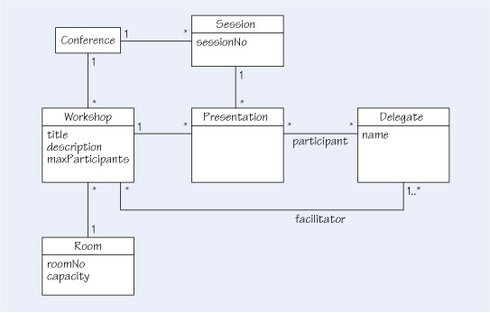

Slide 9
Unit 9 review
Block 3

Slide 10
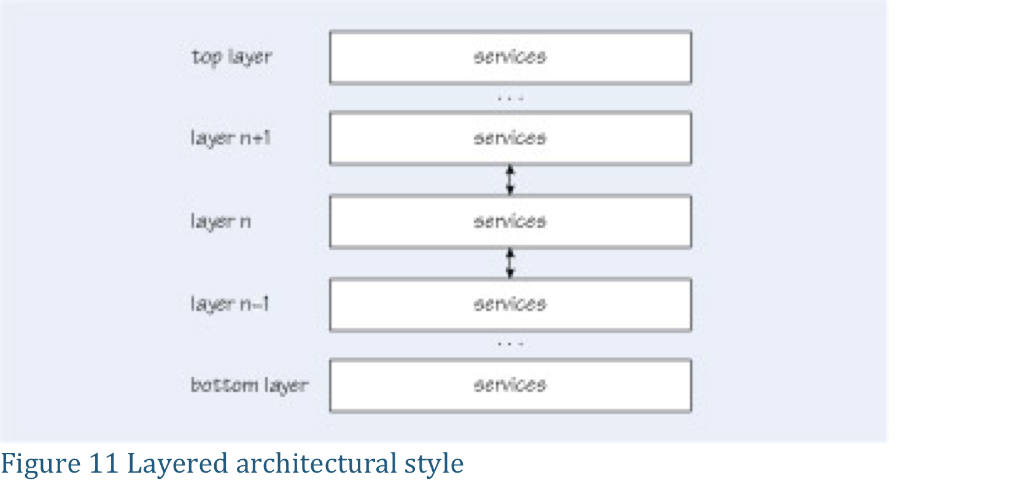
Architectural styles

Slide 11
The Layered style
In this subsection we describe a widely adopted architectural pattern: the Layers pattern. The following description is based on that of Buschmann et al. (1996).
Name Layers.
Intent To help structure the architecture of a system into groups of subfunctions, each at a particular level of abstraction.
How it works The system is structured into an appropriate number of layers, which are then (logically) placed on top of each other, with each layer making use only of services provided by the layers below it.
When to use it This pattern applies in the development of large complex systems, which require decomposition, in particular when there is a mix of low­ and high-level issues to be addressed.
Example Networking protocols (e.g. the ISO OSI seven-layer model) are probably the best known examples of layered architectures. Such protocols usually consist of a set of rules and conventions that describe how computers communicate across machine boundaries and over networks. They are usually organised in subprotocols at various levels of abstraction, ranging from the physical layer (dealing with transferring electrical signals on a physical network) up to the application layer (dealing with transferring data between remote applications).

Slide 12
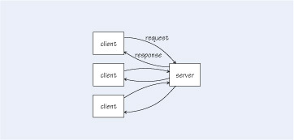
Figure 9 Client–server architectural style

Slide 13
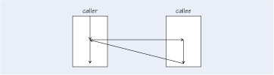
Figure 10 Call-return architectural style

Slide 14
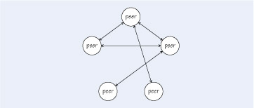
Figure 12 Peer-to-peer architectural style

Slide 15
Frameworks
Reusing part of the architectural model of the previous systems, along with the code that is common.
The framework contains some code for the framework itself, most of the code would be for components that could be slotted into the framework.
These components would be stored in a component repository.
Each framework would be accompanied by suitable documentation to facilitate its use.

Slide 16
Product lines
It frequently happens that a company wants to produce many similar software systems.

Slide 17
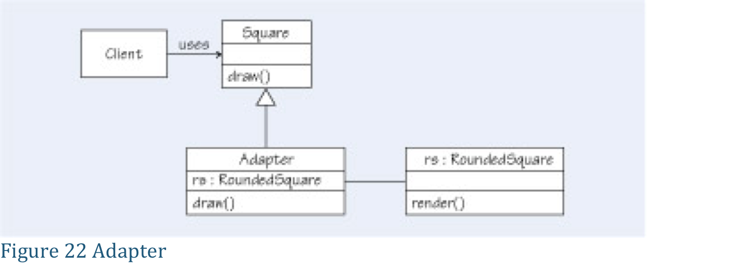
Design Patterns

Slide 18
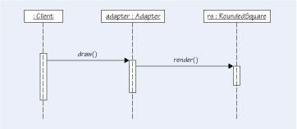
Figure 23 Forwarded message

Slide 19
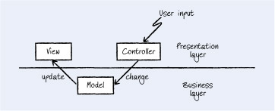
Figure 29 Model-view-controller pattern

Slide 20
Observer

Slide 21
Singleton

Slide 22
Factory

Slide 23
Question 1
Discuss the relationship between architecture, requirements and the mediating role of specification. (p6-17)

Slide 24
Question 2
We describe architectural reuse in terms of styles, frameworks and product lines, briefly define what we mean by each with an example (p21-30).

Slide 25
Question 3
Design patterns are a way to codify commonly seen features in object-orientated program code. Explain why it is useful to identify them. (p31-51)

Slide 26
Question 4
Discuss the relationship between architecture, design, reuse and agile methods, are they compatible? (p11-12)

Slide 27
Looking ahead, units 10 & 11
Block 3

Slide 28
Unit 10

Slide 29
Software components

Slide 30
Service and Component Architectures
In many ways services resemble components, and indeed components can be used to implement services. Like components, services:
have well defined interfaces which specify how other software can interact with them
aim to be loosely coupled, by not exposing details of their implementation, thus allowing it to be changed without disturbing other parts of the system
can be composed – services can be combined to build up more complex functionality
aim to be reusable, so that the same service can be used as part of many different applications.

Slide 31
Difference
Communication with components tends to depend on proprietary technologies, which restricts interoperability. Services use standard communication protocols, which allows them to interoperate in a platform- and language-independent way.
Services are discoverable. Clients can access a repository to find details of available services.
Components run on computers controlled by the organisation using them and if many organisations use a component it executes in multiple locations. A service in contrast resides on a provider server, typically owned by a different organisation, and executes at a single end-point that all clients communicate with.
Services should be autonomous and as far as possible independent of other services. So, for example, they do not have a ‘requires’ interface.

Slide 32
Quality attribute scenarios
Part of scenario Types of value
Source end users
Stimulus user wants to: – learn system features – use system efficiently – minimise impact of errors – feel comfortable
Artefact system
Environment setting preferences using system
Response one or more of: – supporting learning – supporting efficient use – minimising impact of errors – allowing adaptation – making user comfortable
Response measure task time number of errors number of problems solved user satisfaction success rate time taken or data lost
Source: adapted from Bass et al, 2003

Slide 33
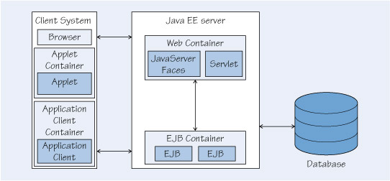
Enterprise Java beans

Slide 34
Unit 11

Slide 35
Verification and validation
Verification is the process of checking that a given system description S is self-consistent, and that system descriptions that are derived from S are consistent with S. For example, a class diagram is one description of a system, and the code is another. If the code is not consistent with the class model, then verification should fail. Barry Boehm (1984) put it concisely when he said that verification answers the question: ‘are we building the product right?’
Validation is the process of checking that each system description is consistent with the customer’s requirements – that the system does what the customers want it to do. Referring to Boehm (1984) again, validation answers the question: ‘are we building the right product?’

Slide 36
Testing
Testing is the process of exercising software to check that it does what it is supposed to (and doesn’t do what it is not supposed to). All software contains flaws and during testing we aim to detect as high a proportion of them as possible, so that they can be rectified before the software is released. In other words, it is any form of validation or verification that operates on program code.

Slide 37
Types of testing
usability testing, which is discussed in the course M364 Fundamentals of Interaction Design;
developmental testing, which checks that developmental activities have been carried out correctly, and ideally it is performed by development staff other than the authors of the code and checked by quality assurance (QA) staff;
requirements-based testing, which checks that a system meets the customer’s requirements, and it is carried out by QA staff in conjunction with the customer;
regression testing, which occurs during developmental testing and system maintenance, and checks that fixing one bug has not introduced others.

Slide 38
Metrics
Lines-of-code metric
A very simple measure of the complexity of a system description is given by counting the number of lines in the description. When the system description is a piece of code, the metric produced is called the lines-of-code (LOC) metric.
McCabe’s cyclomatic-complexity metric
Tom McCabe (1976) introduced the very popular, and still widely used, cyclomatic-complexity metric. To compute the metric, we find the number of independent paths, taking into consideration the branches.

Slide 39
Verification approaches
Test driven development
This is where we create tests before the code, and then only accept the code when the tests are met. Often it is combined with automated testing using tools such as JUnit (or similar).
Design by Contract
Preconditions describe the conditions that must be true before an operation can be used (before the client can request the service), and the postcondition describes the result of the operation (what the supplier is expected to do).

Slide 40
Black box and White box tetsing
The essential difference between our two categories of testing technique is the way in which tests are designed:
in black box testing we design test cases by looking at the specification (that is, requirements and high-level design) of the system to be tested;
in white box testing we design test cases by looking at the detail of the implementation of the system to be tested.

Slide 41
Next tutorial
Work though TMA style questions as a group.
Identify common errors that students make.

